Slide 1

Welcome to World Sustainability Fund General Assembly Meeting
01-12-2017

Slide 2

MEETING INTRODUCTION | 5 min
INTRODUCTION WSF- EMILE | 7 min
2. SERVICE LEVELS Services- Lead Link Ton Wurtz Status Update | 30 min 9 min
Private- Lead Link Emile Van Essen Status Update | 2 min
City and businesses- Lead Link Richard Pearson Status Update | 2 min
Country- Lead Link Ingrid Collins & Cathy Delhanty Status Update | 15 min
UN&MG- Lead Link Emile van Essen Status Update | 2 min
3. GROUP PHOTO! | 5 min

Slide 3
4. OPERATIONAL SUPPORT Marketing- Lead Link Wendy Brown Status Update | 45 min 10 min
HRM- Lead Link Sibel Yalap & Samar Siala Status Update | 10 min
Finance- Lead Link Harold Dhalganjansing Status Update | 10 min
Policy- Lead Link Nicolas De Gros Status Update Capacity building | 13 min
Management bureau- Lead Link Christelle Doumit Status Update | 5 min
5. Q&A WITH EMILE | 15 min
6. MEETING CLOSURE | 2 min

Slide 4
Service Levels |  |  |  |  | Operational Support
Services | Private | City&Bis | Country | UN&MG | Marketing | HRM | Finance | Policy | Mg. Bur.
TON | .../Emile | RICHARD | INGRID + CATHY | .../Emile | Wendie | SIBEL + SAMAR | HAROLD | Nicolas | CHRISTELLE
Fund for Funds | Resarch | Resarch | Global Mgt. | Focus Groups | PR - Branding | Planning | Funding | Strategy | EvE Office
Consultancy | Experts | Experts | R&D, Toolkits | Experts | Website | Recuit | Admin. | Accreditation | C & B sup.
Education | Program | Program | Countries | Program | Members+ | Admin. | Oper.Fin | Process Eng. | Mgt. Team
CDM | Projects | Projects | PDD | Projects | Events | Job support | Asset Mgt | Scorecard | Key Partners
SDG | Partners | Partners | Partners | Partners | News & MM | Education | Control | Security | General
Projects | EVS Education |  |  |  | Language |  | Legal | ICT | ECOIntention

Slide 5
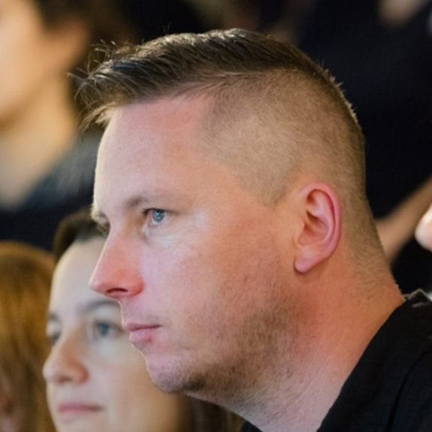
Nicolas Gros de Seta

Slide 6
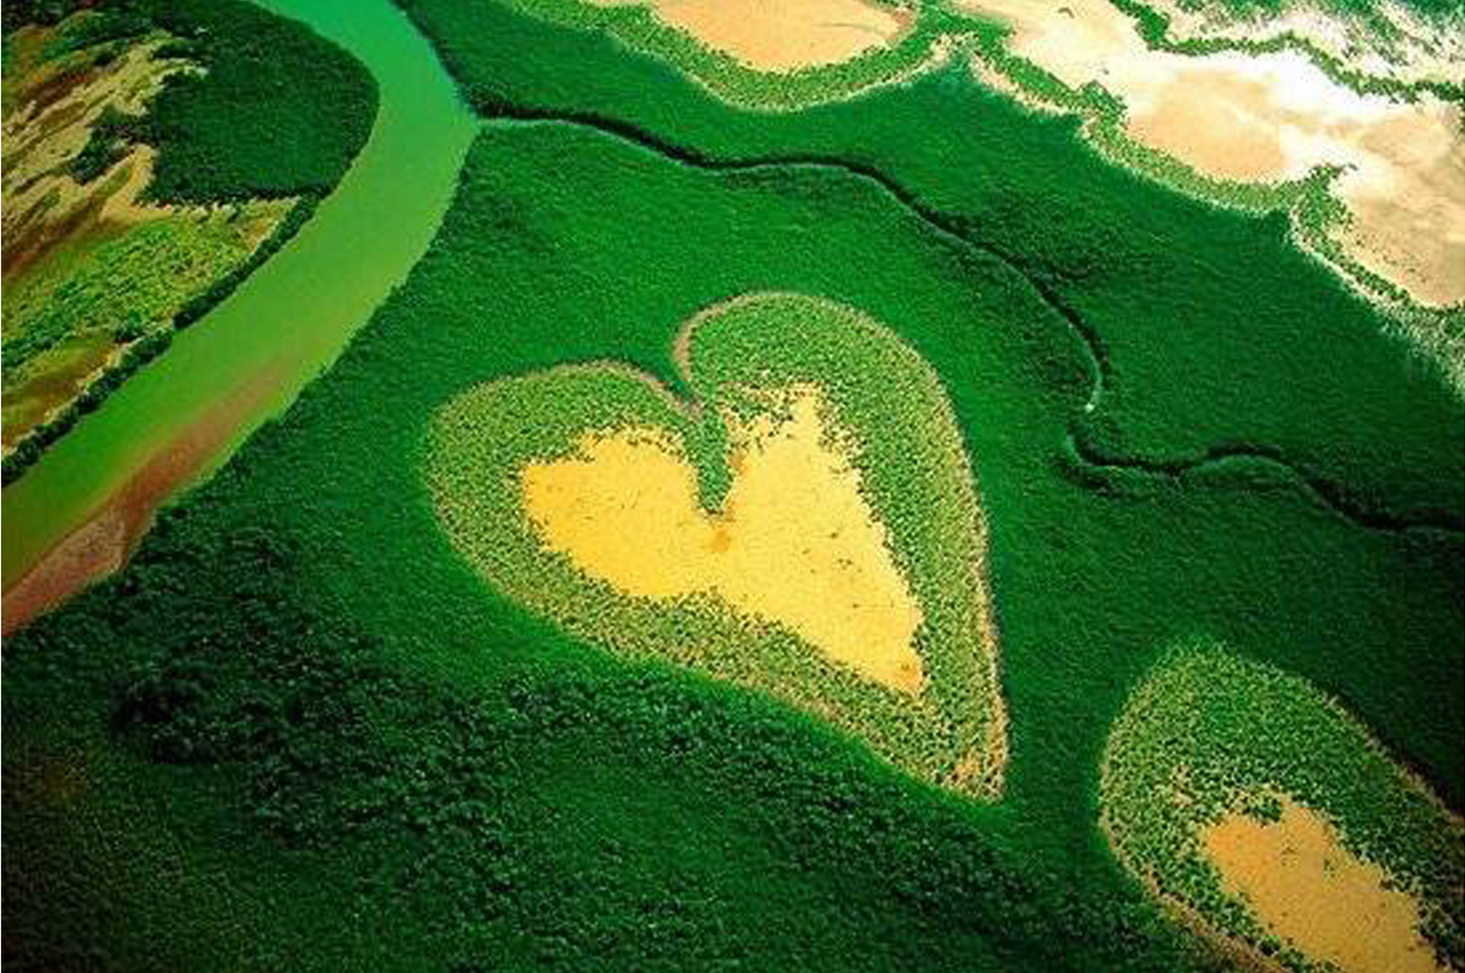


Slide 7
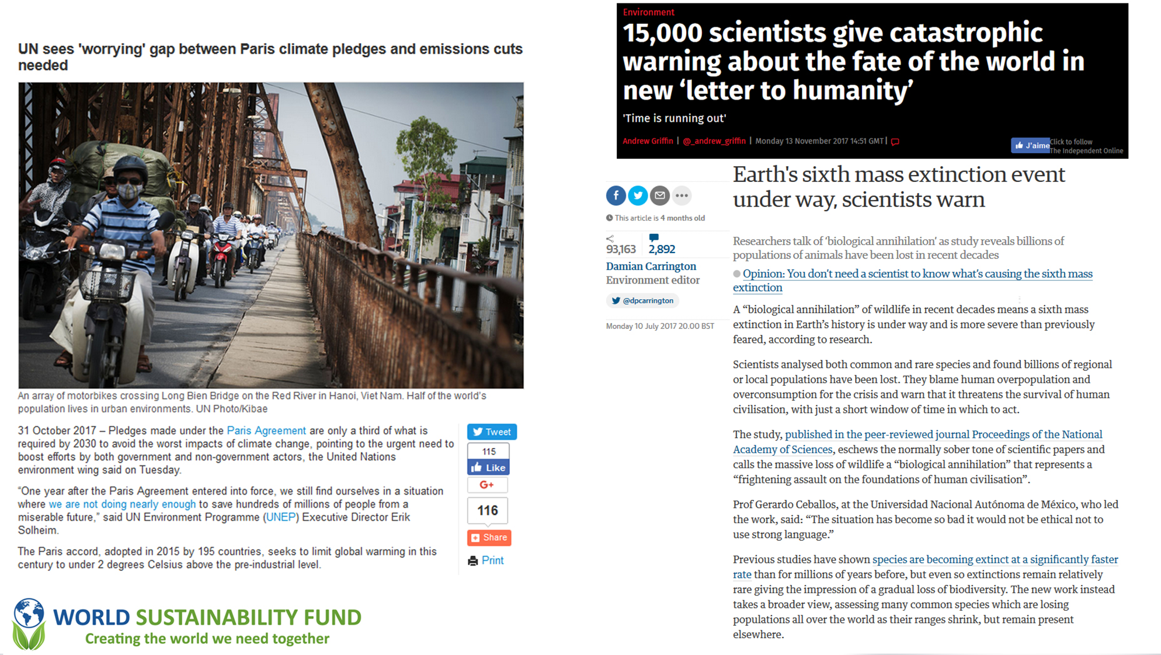

Slide 8


Slide 9
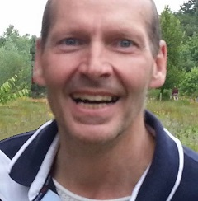
Emile Van Essen

Slide 10
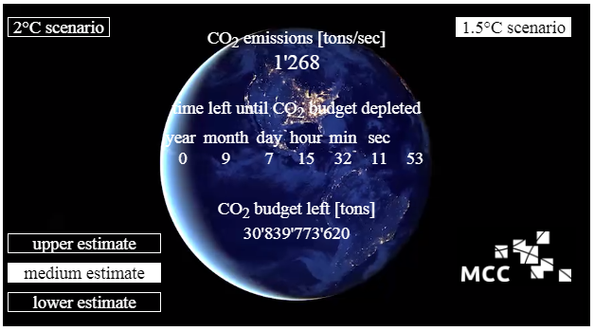

00:00 Dec. 1, 2017
15:32 August. 8, 2018

Slide 11
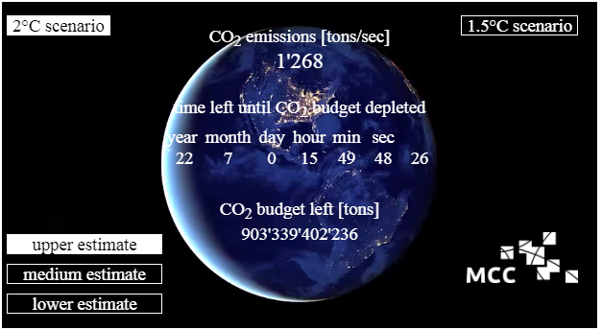
00:09 Dec. 1, 2017
15:49 July 1, 2030

Slide 12


World Sustainability Fund
WHY
We have to solve the climate problem within 25 years.
We like to solve humanitarian problem at the same time
. Poverty, hunger, health, sanitation, equality, peace,……..
Because we like to live is prosperity and pass this through to the next generation
Create The World We Need Together
By transforming our lives,work, social structures & economics

Slide 13

Climate & Social Economic Solutions
The United Nations arranged technological green standards – CDM
And asked every country to write a green and social plan – INDC
Also they asked financial institutions to support – CDP
Then they delivered a global Agenda 2015–2030 – SDG
And asked everyone to support, so …
WSF Supports with massive capacity building
By connecting those points
For best practice sample
In every country within three years
WSF How

Slide 14

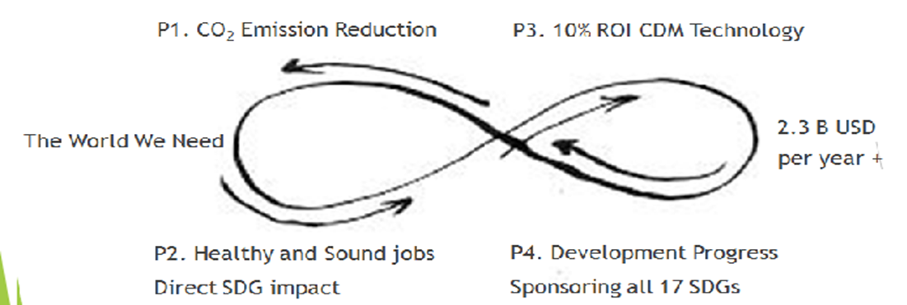

CDMs creating values for SDGs
1- Planet
2- People
3- Profit
4- Progress

Slide 15



WSF 200 Country Program, sample
Priority Projects Profiles Amount in USD
Renewable Energy (WIND) | 10,000,000
Renewable Energy (SOLAR) | 10,000,000
Renewable Energy (HYDRO) | 10,000,000
Energy Distribution | 10,000,000
Energy Demand | 10,000,000
Transportation | 10,000,000
Waste Handling | 10,000,000
Afforestation | 10,000,000
Reforestation | 10,000,000
Agriculture | 10,000,000
 | 100,000,000
Program
under
U.N. protocol
CDMs creating values for SDGs

Slide 16
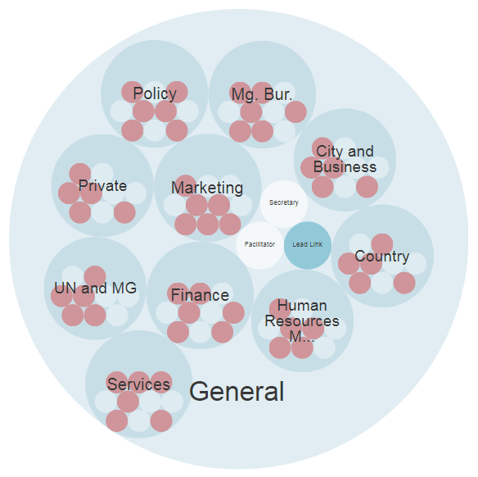
WSF – CDM & SDG ORGANIZATION
Services
Fund for Funds
CONSULTANCY & Education
CDM
SDG
PDD
Service Levels
Council, Board & Support
Personal, HOME & leisure
Habitat, LABOR & business
Province, COUNTRY & region
Federation, WORLD & groups
Asset, VIGOR & promotion
Vision, MISSION & support
Holacracy Delegated Power to act
Super-Circle, Circles & Sub-Circles
Domain, Purpose & Accountabilities
Roles: Rep Link, Lead Link, Facilitator,
Secretary & … Programs, Projects & Actions
Tensions Tactical & Governance Meetings
Notes:
Enlarging the service range for all levels with basics, webshop, and Membership program. Starting as reseller of for instance LED TL tubs for 65% energy saving, solar panels, and windmills.

Slide 17
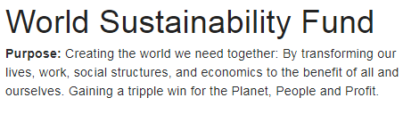
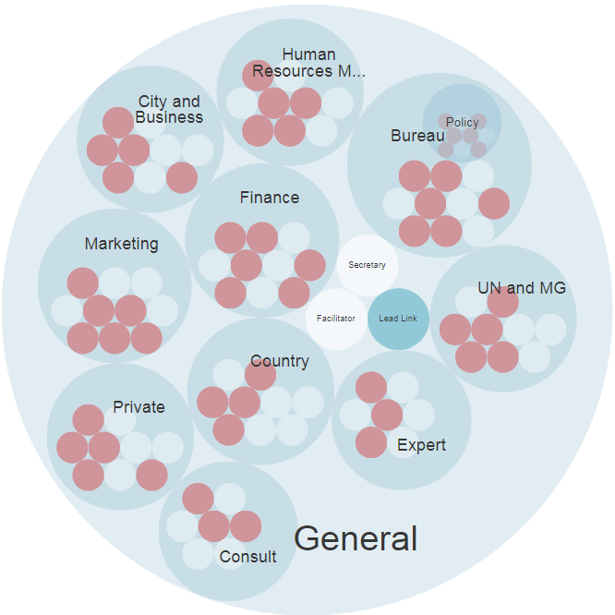
Notes:
Enlarging the service range for all levels with basics, webshop, and Membership program. Starting as reseller of for instance LED TL tubs for 65% energy saving, solar panels, and windmills.

Slide 18
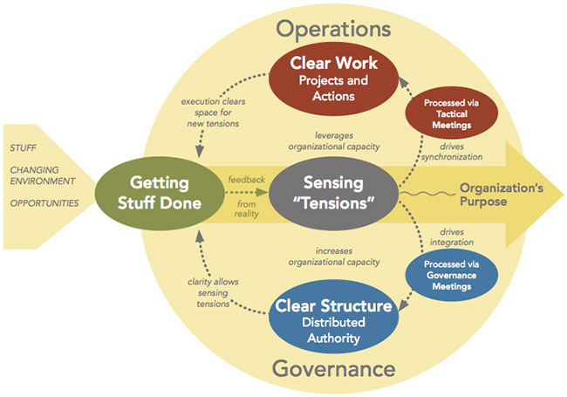
Holacracy - Tactical & Governance Meetings

Slide 19

Spiral Dynamics Culture
Pro-activity
An open mind
Passion
Positive attitude
Turquoise:
Holistic Meme
Yellow:
Integrative Meme
Green:
Communitarian
Orange:
Activist
Blue:
Authoritarian
Red: Impulsive
Purple: Magical
Beige: Instinctive

Slide 20
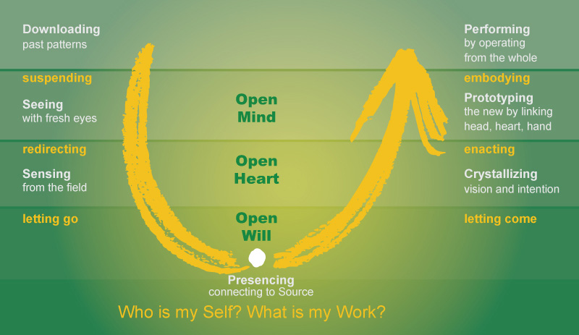
Theory U

Slide 21
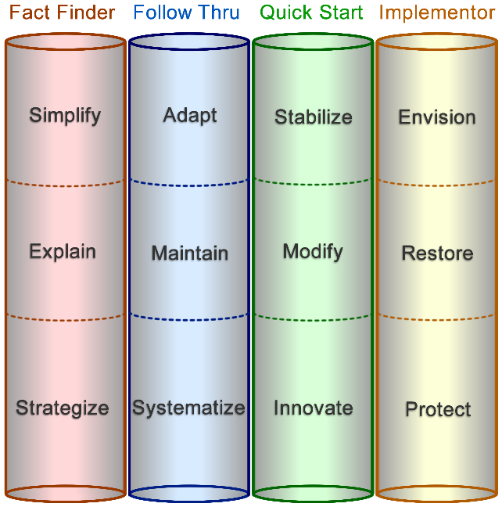

Where we are now in the process
Facilitator

Slide 22
Mind, heart, Body reflection
Future
1. The Logic
3. The Librarian
2. Awareness Unit
Truth
---- Interpretations
------- Misinterpretations
Time - History

Slide 23
Board
Emile van Essen (Founder, President, U.N. contacts)
Daniëlle Simons (Vice-President, Legal)
Güniz Çulcu van Cres (Secretary General,
Mgt Bureau - Christelle Doumit)
Harold Dhalganjansing (Treasurer)
Nicolas Gros de Seta (Organization Developer)
Rambha Kumari (Country R&D,
Country Mgt – Cathy Delhanty and Ingrid Collins)

Slide 24
Service Levels |  |  |  |  | Operational Support
Services | Private | City&Bis | Country | UN&MG | Marketing | HRM | Finance | Policy | Mg. Bur.
TON | .../Emile | RICHARD | INGRID + CATHY | .../Emile | Wendie | SIBEL + SAMAR | HAROLD | Nicolas | CHRISTELLE
Fund for Funds | Resarch | Resarch | Global Mgt. | Focus Groups | PR - Branding | Planning | Funding | Strategy | EvE Office
Consultancy | Experts | Experts | R&D, Toolkits | Experts | Website | Recuit | Admin. | Accreditation | C & B sup.
Education | Program | Program | Countries | Program | Members+ | Admin. | Oper.Fin | Process Eng. | Mgt. Team
CDM | Projects | Projects | PDD | Projects | Events | Job support | Asset Mgt | Scorecard | Key Partners
SDG | Partners | Partners | Partners | Partners | News & MM | Education | Control | Security | General
Projects | EVS Education |  |  |  | Language |  | Legal | ICT | ECOIntention

Slide 25
At the moment we are thinking of several "products":
1. Social Profit Investment - CO2 and SDG profit, 0% € $ ¥ return target;
2. Social Profit & Inflation Investment - CO2 and SDG profit plus inflation correction € $ ¥ return target;
3 & 4. Social Profit Medium or High Risk Return Investment - CO2 and SDG profit plus moderate or risky € $ ¥ return target;
5. Customization (sector / region / return) Investment.
Minimum deposit € 100K.

Slide 26
Services
OLA - Observation, library, analysis, decision routines
UNFCCC - U.N. Framework Convention on Climate Change
INDC - Intended Nationally Determined Contributions
CDM - Clean Development Mechanism
SDG - Sustainable Development Goals & Agenda
CFO - Carbon Footprint Offset
Fundamental Services
Fresh Thinking, Diversity and Engagement
Futures exploring, system innovation
Crisis management and inspiration
Breakthrough for Leaders Theatre
Lean, integrated, torus-circular
Human Capital & Technology
Sustainability Assessments

Slide 27
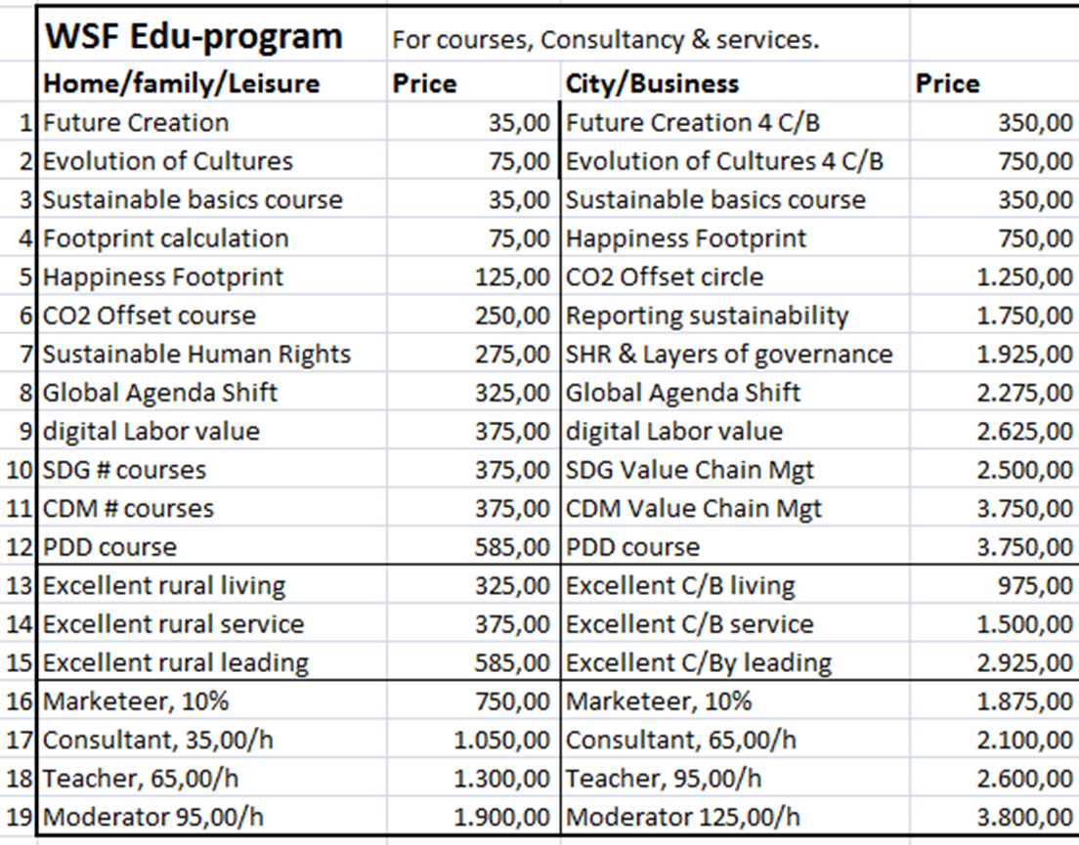

Slide 28
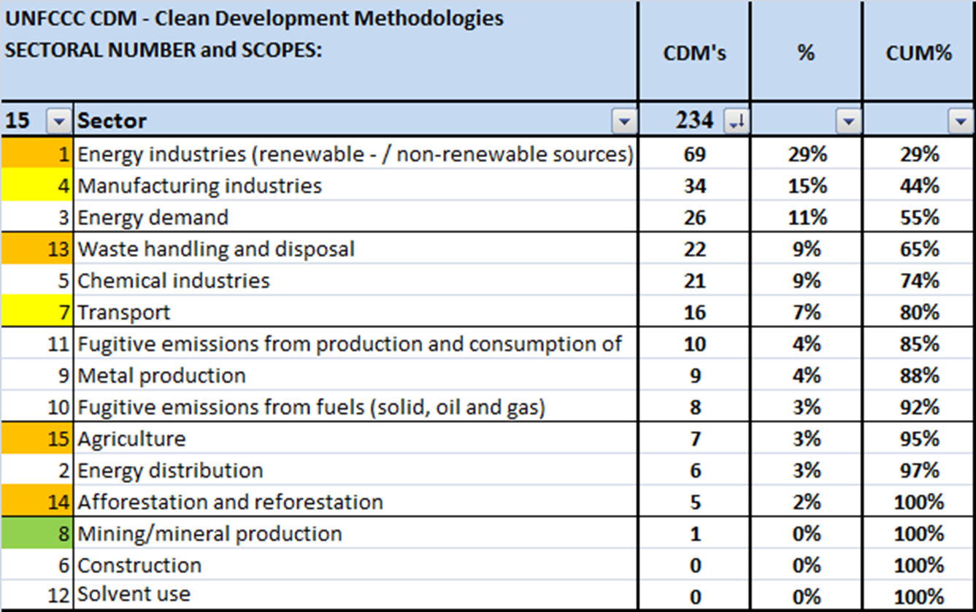

Slide 29


Slide 30
Service Levels |  |  |  |  | Operational Support
Services | Private | City&Bis | Country | UN&MG | Marketing | HRM | Finance | Policy | Mg. Bur.
TON | .../Emile | RICHARD | INGRID + CATHY | .../Emile | Wendie | SIBEL + SAMAR | HAROLD | Nicolas | CHRISTELLE
Fund for Funds | Resarch | Resarch | Global Mgt. | Focus Groups | PR - Branding | Planning | Funding | Strategy | EvE Office
Consultancy | Experts | Experts | R&D, Toolkits | Experts | Website | Recuit | Admin. | Accreditation | C & B sup.
Education | Program | Program | Countries | Program | Members+ | Admin. | Oper.Fin | Process Eng. | Mgt. Team
CDM | Projects | Projects | PDD | Projects | Events | Job support | Asset Mgt | Scorecard | Key Partners
SDG | Partners | Partners | Partners | Partners | News & MM | Education | Control | Security | General
Projects | EVS Education |  |  |  | Language |  | Legal | ICT | ECOIntention

Slide 31
Private
Research
Experts
Program
Projects
Partners
EVS Education

Slide 32
Personal, HOME & leisure
Basic Information, Education, Train & Cert. Consultancy
Measuring Tools Footprint
Webshop for sales of:
- Programs, Education, Project plans, Products & Services
- Products: Solar panels, Windmills, Hydrogen's
Water & Waste tech, LED & E-saving tech
Forest & Agri seeds & tech, E-transport systems
- Membership Program – WSMovement, E-magazine
- Recognition & Certification Global Green Passport
- Special Price Actions & Events
- WS Project Sponsor platform

Slide 33
Service Levels |  |  |  |  | Operational Support
Services | Private | City&Bis | Country | UN&MG | Marketing | HRM | Finance | Policy | Mg. Bur.
TON | .../Emile | RICHARD | INGRID + CATHY | .../Emile | Wendie | SIBEL + SAMAR | HAROLD | Nicolas | CHRISTELLE
Fund for Funds | Resarch | Resarch | Global Mgt. | Focus Groups | PR - Branding | Planning | Funding | Strategy | EvE Office
Consultancy | Experts | Experts | R&D, Toolkits | Experts | Website | Recuit | Admin. | Accreditation | C & B sup.
Education | Program | Program | Countries | Program | Members+ | Admin. | Oper.Fin | Process Eng. | Mgt. Team
CDM | Projects | Projects | PDD | Projects | Events | Job support | Asset Mgt | Scorecard | Key Partners
SDG | Partners | Partners | Partners | Partners | News & MM | Education | Control | Security | General
Projects | EVS Education |  |  |  | Language |  | Legal | ICT | ECOIntention

Slide 34
National
government
Regional
government
Business & civil society

Slide 35
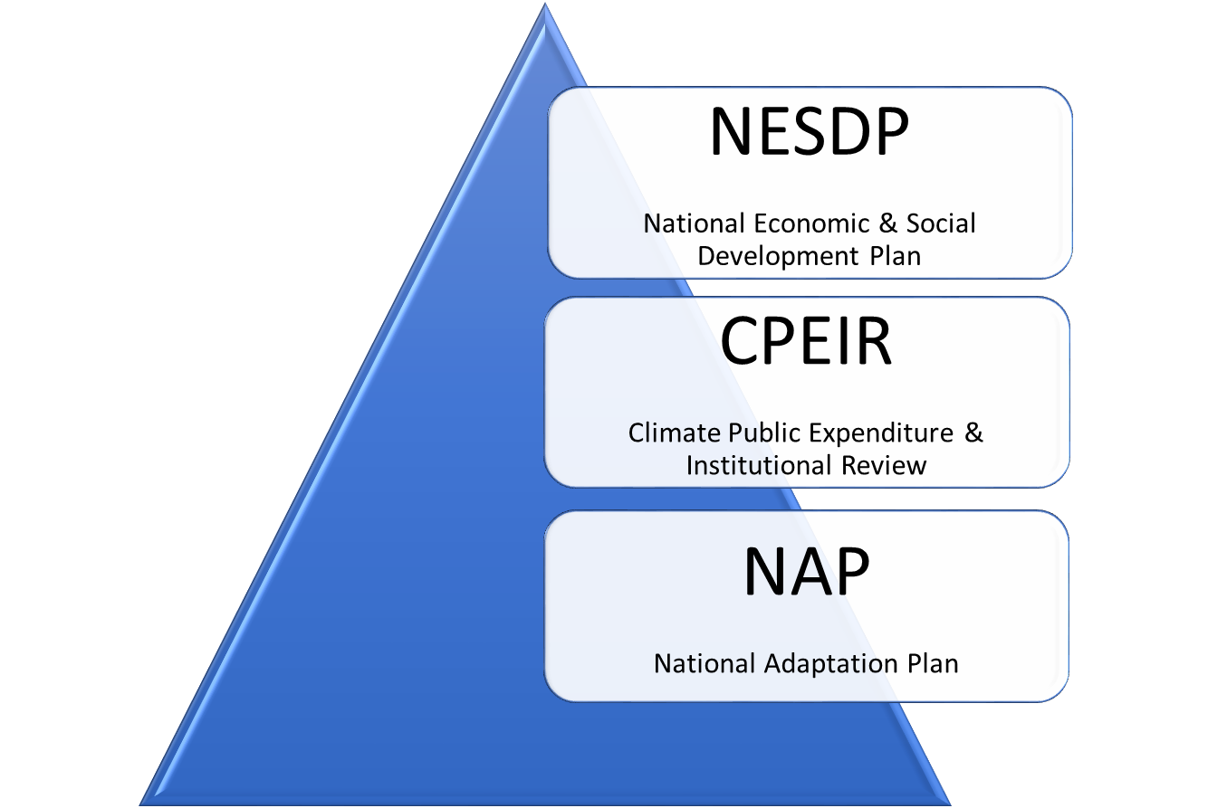

Slide 36
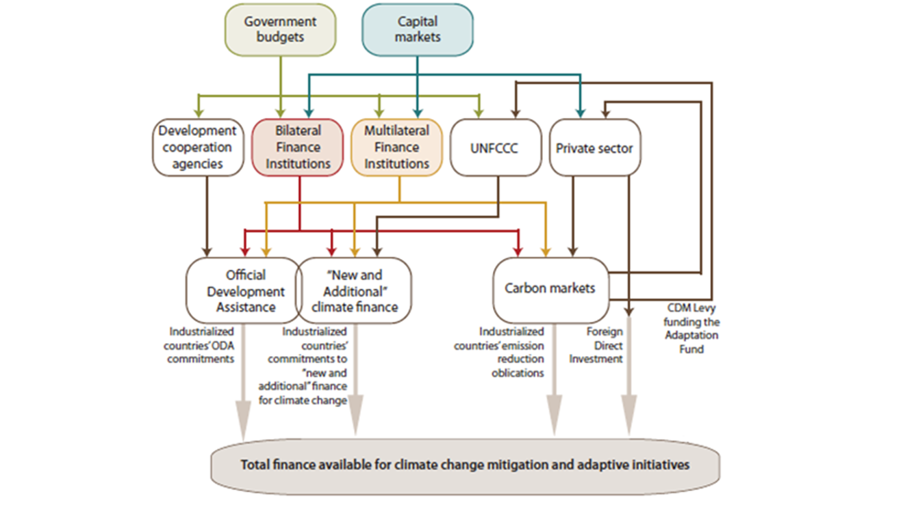

Slide 37
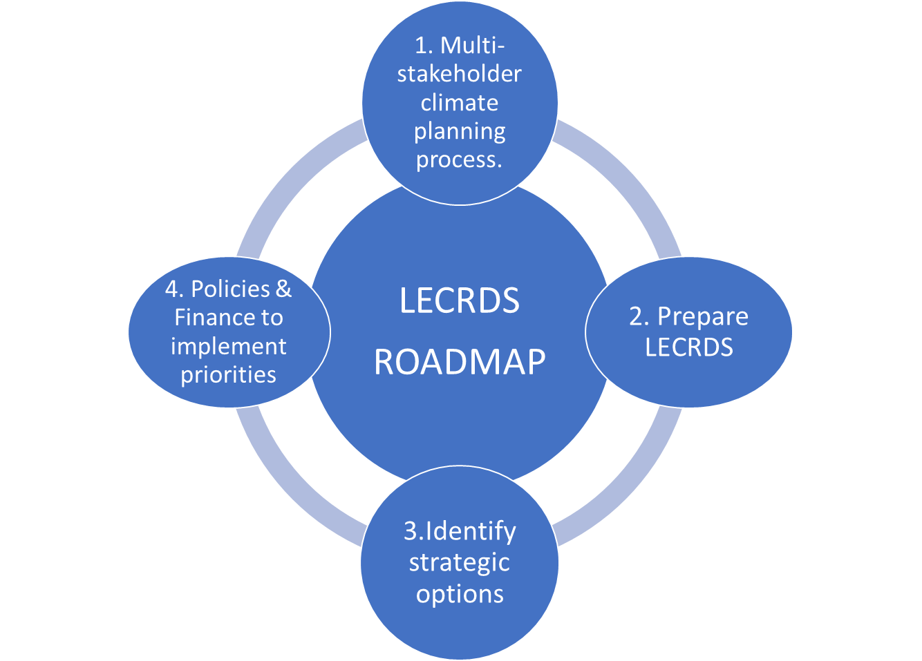

Slide 38
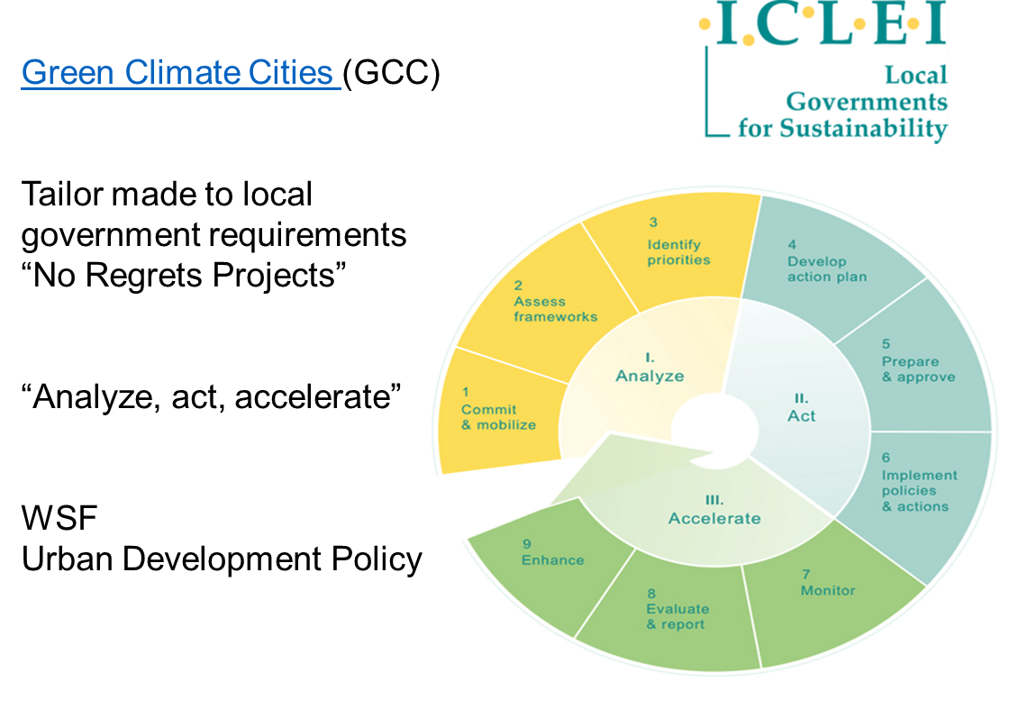

Slide 39
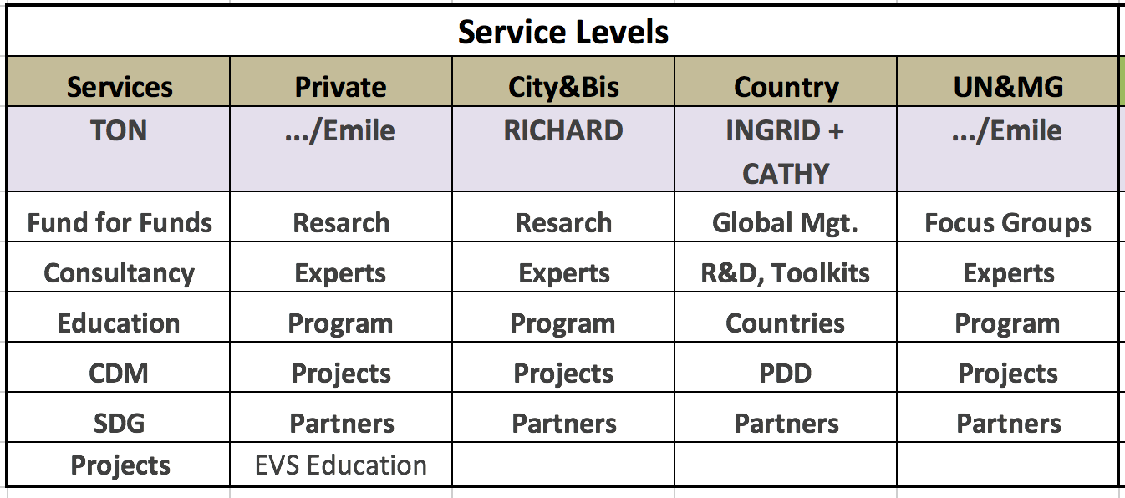
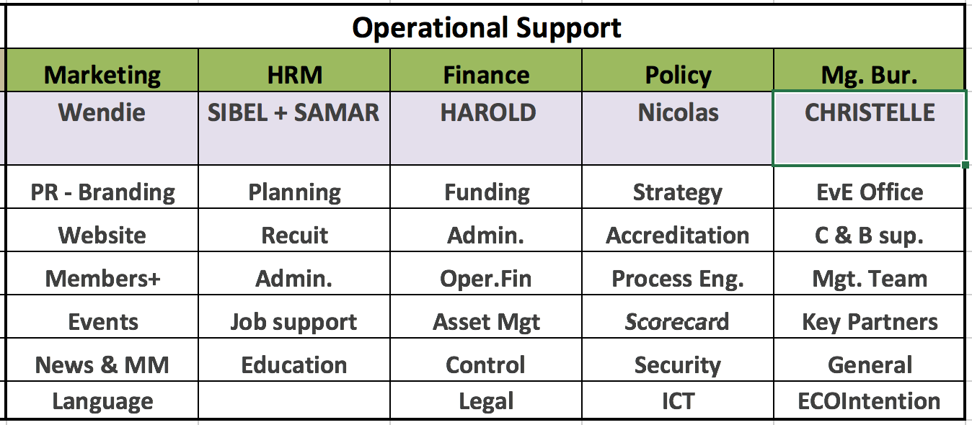
ORGANISATION
Responsibilities: Cathy- ‘clean-up’, Ingrid- ’clean’ countries
Re-structuring of sub-circles underway
R&D, Toolkits (Phase 1) most active sub-circle
Countries- PDD (Project Design Document) development and approval (Phase 2)
Global Mgt- when local offices in place (Phase 3)
PDD- implementation (Phase 3)
Partners- managing external partners

Slide 40
Building out the Countries After the Brochure is Finished
WSF Goals
Assess Current Situation
Per Country Action Plans
Create Momentum
Strengthen Team
Priorities
Dashboard
Vision – 200 countries in 20 months

Slide 41
Understand the Clear Priorities and Urgent Countries
CO₂ Priority
Region
Sustainability Goals
WSF Phase
Developing
Developed

Slide 42
COUNTRY DEVELOPMENT PROCESS
Phase 1
Phase 2
Phase 3
Work towards 10.000 USD* funding
Funds to come from NL dep. of foreign affairs or other
Initial contact GEF, embassy, government
Larger team
Work towards 1 M USD* funding:
Funds to come from UN*, EU or private investors or others
Set up local office
Project Design Document prep.
Work towards 100 M USD* funding:
Funds to come from UN (GEF, GCF etc.)
PDD UN approval
Project implementation
Project recycling
STAGE 1 & 2
Toolkit+ brochure analysis and research
Country presentation
STAGE 3
STAGE 4,5 & 6
*WSF needs to be accredited
* The exact amount required depends on the country
Notes:
Stage/ funds required/ sources of funds/ main activities:

Slide 43
IMPROVEMENTS WE NEED TO MAKE
Country
HRM
Finance
CO2/ capita
GDP
Happiness index
Prioritize countries -structured approach will increase confidence, opportunities will still be seized
Operational support– closer collaboration, in particular with the HRM and finance circles
People– more influence, involvement, clarity, education, collaboration, quicker response times
Stage 1
Building a team
Stage 2
Stage 3
Local office
Stage 4,5,6
PDD
Stake-holders
Starting projects
Processes & strategy –build detailed project plans, balanced scorecard etc
Notes:
Prioritize countries- ad-hoc (will still exist)+ structured (will increase confidence). Regions. Regional approaches
Build processes –e.g. country entry project plan with detailed steps and templates.
Strategy- balanced scorecard- set goals for e.g. finance, customer, internal business processes, learning and growth. The policy circle (Amrin/ Nico) will also be important.
Operational support- Building processes with HR to ensure newcomers are properly welcomed, changes in roles communicated, e-mail lists are up-to-date, develop training programme so all volunteers have the same knowledge platform.
People- One-on-ones to ensure circle volunteers’ expectations are met, roles & responsibilities are clear, Education-, quicker response times- need people to update, add information in the brochure and toolkit templates- please let us know in the next country circle meeting on Dec 13, or send us an email.

Slide 44
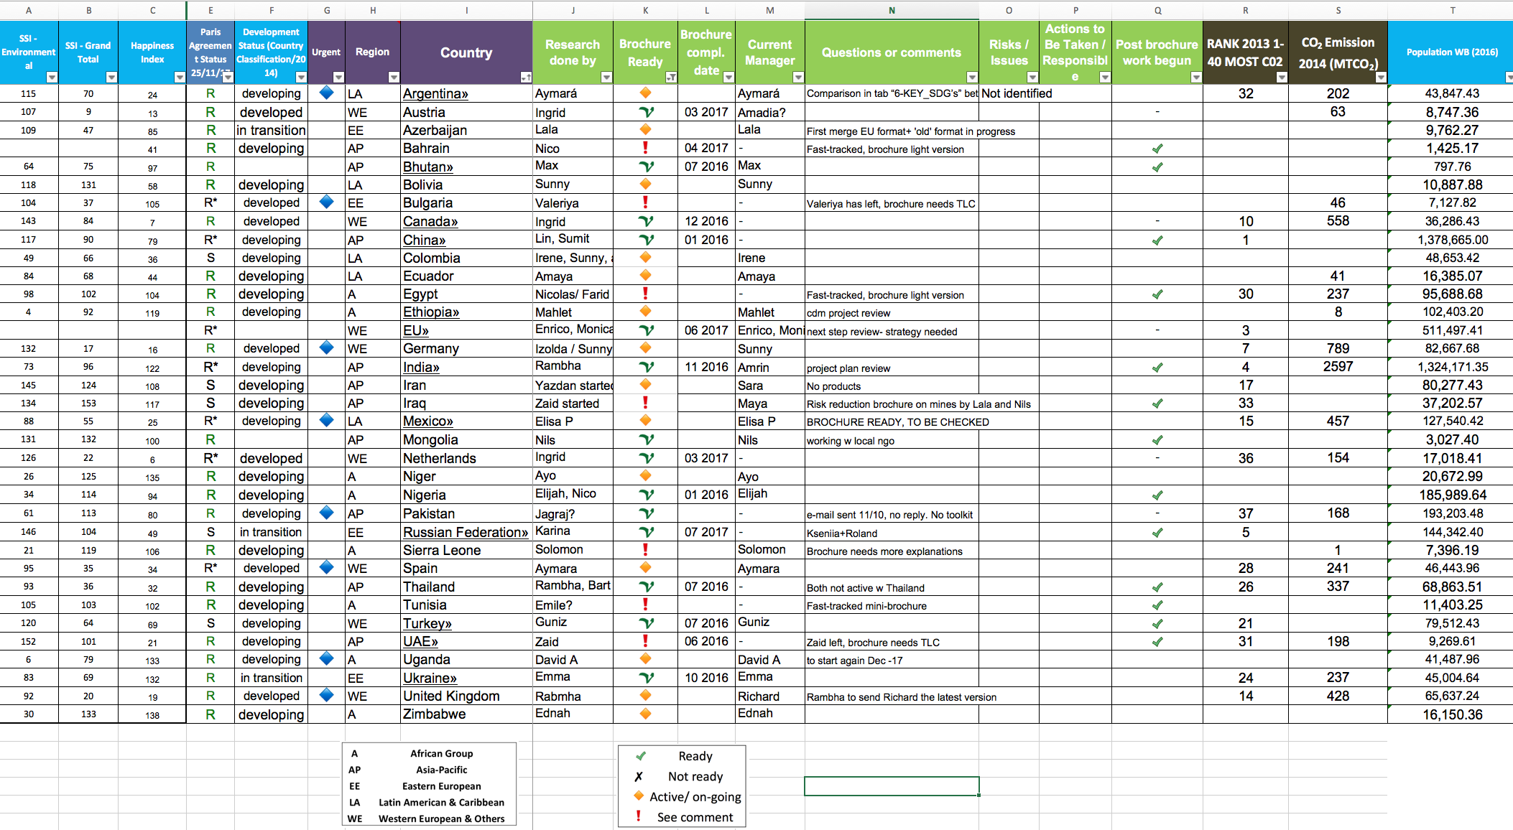
COUNTRIES IN THE PIPELINE

Slide 45
Service Levels |  |  |  |  | Operational Support
Services | Private | City&Bis | Country | UN&MG | Marketing | HRM | Finance | Policy | Mg. Bur.
TON | .../Emile | RICHARD | INGRID + CATHY | .../Emile | Wendie | SIBEL + SAMAR | HAROLD | Nicolas | CHRISTELLE
Fund for Funds | Resarch | Resarch | Global Mgt. | Focus Groups | PR - Branding | Planning | Funding | Strategy | EvE Office
Consultancy | Experts | Experts | R&D, Toolkits | Experts | Website | Recuit | Admin. | Accreditation | C & B sup.
Education | Program | Program | Countries | Program | Members+ | Admin. | Oper.Fin | Process Eng. | Mgt. Team
CDM | Projects | Projects | PDD | Projects | Events | Job support | Asset Mgt | Scorecard | Key Partners
SDG | Partners | Partners | Partners | Partners | News & MM | Education | Control | Security | General
Projects | EVS Education |  |  |  | Language |  | Legal | ICT | ECOIntention

Slide 46
UN & MG
Focus Groups
Experts
Program
Projects
Partners

Slide 47
United Nations & Major Groups
Start at 2003 WHO
2007 Poverty → Sustainability → 2015-2030 SDG
2011 WSF Dec 9th “Plan B”
UNFCCC Climate change, CDM, CER, FUNDS
UNEP, UNDP, UNSD Steering Committee Rule of law & governance
Major Groups: Farmers, Industry, Women,

Slide 48
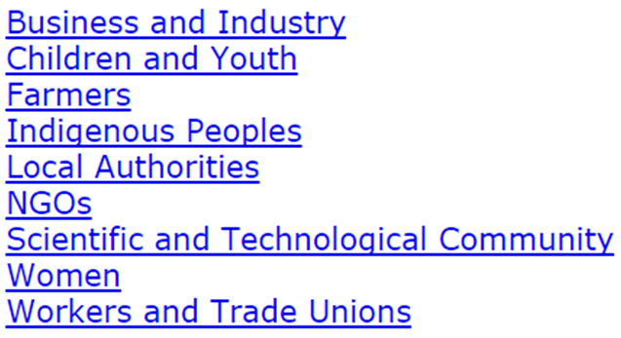
U.N. MAJOR GROUPS

Slide 49
Global Structures
World Federal Movement, World Economic Forum, BRICS
ASIA INFRASTRUCTURE INVESTMENT BANK (AIIB)
BANCO INTERAMERICANO DE DESARROLLO
CENTRO INTERNACIONAL DE ARREGLO DE DIFERENCIAS RELATIVAS A INVERSIONES
CIF, IMF, UN, WORLD BANK GROUP
WTO

Slide 50
SAY CHEESE!!

Slide 51
Service Levels |  |  |  |  | Operational Support
Services | Private | City&Bis | Country | UN&MG | Marketing | HRM | Finance | Policy | Mg. Bur.
TON | .../Emile | RICHARD | INGRID + CATHY | .../Emile | Wendie | SIBEL + SAMAR | HAROLD | Nicolas | CHRISTELLE
Fund for Funds | Resarch | Resarch | Global Mgt. | Focus Groups | PR - Branding | Planning | Funding | Strategy | EvE Office
Consultancy | Experts | Experts | R&D, Toolkits | Experts | Website | Recuit | Admin. | Accreditation | C & B sup.
Education | Program | Program | Countries | Program | Members+ | Admin. | Oper.Fin | Process Eng. | Mgt. Team
CDM | Projects | Projects | PDD | Projects | Events | Job support | Asset Mgt | Scorecard | Key Partners
SDG | Partners | Partners | Partners | Partners | News & MM | Education | Control | Security | General
Projects | EVS Education |  |  |  | Language |  | Legal | ICT | ECOIntention

Slide 52

Theme: “A WAY FORWARD….”
Marketing Department
Presented by: Wendie M. Brown

Slide 53
Meet the Team:
Marketing & Sales
Marketing & Design
Bart Mullink
Katrina Smyrli
Leila Samadi
Maryam Farahmand
Wendie Brown
Alanna Santos
Karolina Petrauskaite

Slide 54
About the Marketing Department
Draft Marketing Plan: 2018
Officially launched to the management team on Nov. 15
Rolled out to the Marketing team on Nov. 22
Objectives
Benefits
Combine range of strategies to:
create awareness,
generate a positive image by communicating effectively with targeted audiences
secure funding/investments
increase participation and outreach
Gain credibility and loyalty
Build and sustain membership / gain volunteers more quickly
Maintain existing donor relations while making it attractive to build new ones

Slide 55
About the Marketing Department
Draft Marketing Plan: 2018
Officially launched to the management team on Nov. 15
Rolled out to the Marketing team on Nov. 22
Goals: #s to be updated
Priorities
Priorities
We expect to engage:
# of new donors
# of new volunteers
# of new board members this year
# launch various fundraising initiatives
# results in $s
# of programs/services delivered
# serving number of people
Revamping of Online presence
Soft launch in Jan. 2018
Publish a newsletter for Dec. 19
Solidifying our messages and brand e.g.: logos, taglines, print copes etc.
Create more of a buzz with public messages
Create a 2018 budget

Slide 56
About the Marketing Department
Highlights of some of the Tactics:
Membership packages incentives:
Bronze member: 1.500 and up Silver member: 5.000 and up
Gold member: 10.000 and up Platinum member: 100.000 and up
And the coveted “Emile van Essen Club” member: 1 mil and up
Tactics:
Tactics: Website re-launch
Establish our Brand/position:
Clarification of mission and vision
Tagline: Is 3 or 4 Ps:– Planet, People, Progress, Profit
Revamping our Messages and Contents
Relationship Building/Community Outreach
Refresher Training for volunteers
Maximize for PR advantage
Attractive to multiple users
Package/allocated the information so that it is user friendly with significance
Cleaning up home page – less dense and top heavy
Update logos and graphics that can be adaptable to a wider audience
Ability to refresh messages
Provide a reason for return visit or use

Slide 57
About the Marketing Department
Closing Thoughts:
It is critical to consider that the impression that WSF makes and the experience people have with it are expressed by everything that represents us, from:
The look and content of all print and electronic materials
The quality of the programs/ events
The attitude of the staff
The board members who represent the organization and
The alliances that are made

Slide 58
Service Levels |  |  |  |  | Operational Support
Services | Private | City&Bis | Country | UN&MG | Marketing | HRM | Finance | Policy | Mg. Bur.
TON | .../Emile | RICHARD | INGRID + CATHY | .../Emile | Wendie | SIBEL + SAMAR | HAROLD | Nicolas | CHRISTELLE
Fund for Funds | Resarch | Resarch | Global Mgt. | Focus Groups | PR - Branding | Planning | Funding | Strategy | EvE Office
Consultancy | Experts | Experts | R&D, Toolkits | Experts | Website | Recuit | Admin. | Accreditation | C & B sup.
Education | Program | Program | Countries | Program | Members+ | Admin. | Oper.Fin | Process Eng. | Mgt. Team
CDM | Projects | Projects | PDD | Projects | Events | Job support | Asset Mgt | Scorecard | Key Partners
SDG | Partners | Partners | Partners | Partners | News & MM | Education | Control | Security | General
Projects | EVS Education |  |  |  | Language |  | Legal | ICT | ECOIntention

Slide 59
Meet the Team
Sibel Yalap – Lead Link
Samar Siala – Lead Link
Jessica Chiroma – HR Assistant
Daria Goncharov – HR Assistant
Damla Arslan – HR Assistant
Karolina Balash – HR Assistant
Bhavya Katapady – HR Assistant
Beatrix Nagy – Internal Education

Slide 60
HRM
Planning
Recruitment
Administration
Job Support
Internal Education

Slide 61
HRM
HR Planning is to detect the need of the organization and to implement polices and procedures that facilitate the HR operations and then to the whole organization.
HR Recruitment helps to hire competent, high-performing employees who can sustain their performance over long-term.
HR Administration assist and support the recruitment process with the proper documentation, this includes contract, email address and access to the right documentation as well as maintaining filing system.
Job support: is the link between HR and the rest of the organization and has the responsibility of the onboarding process, and orienting new hires to get familiarized with the organization’s culture.
Internal Education: to provide volunteers with the required learning & development they need to perform properly.

Slide 62
Current Status - Focusing on recruitment
-Administration
Challenges - Reaching the recruiting goal.
-Communication
- Retaining volunteers
Accomplishments
-hired 25 volunteers
- HR team hired
- HR tools
What's next
- Plan 2018
- Build strong HR department.

Slide 63
Service Levels |  |  |  |  | Operational Support
Services | Private | City&Bis | Country | UN&MG | Marketing | HRM | Finance | Policy | Mg. Bur.
TON | .../Emile | RICHARD | INGRID + CATHY | .../Emile | Wendie | SIBEL + SAMAR | HAROLD | Nicolas | CHRISTELLE
Fund for Funds | Resarch | Resarch | Global Mgt. | Focus Groups | PR - Branding | Planning | Funding | Strategy | EvE Office
Consultancy | Experts | Experts | R&D, Toolkits | Experts | Website | Recuit | Admin. | Accreditation | C & B sup.
Education | Program | Program | Countries | Program | Members+ | Admin. | Oper.Fin | Process Eng. | Mgt. Team
CDM | Projects | Projects | PDD | Projects | Events | Job support | Asset Mgt | Scorecard | Key Partners
SDG | Partners | Partners | Partners | Partners | News & MM | Education | Control | Security | General
Projects | EVS Education |  |  |  | Language |  | Legal | ICT | ECOIntention

Slide 64
Meet the Team
Harold Dhalganjansing – Lead Link
Amrin Shaikh – Fundraising Administrator
Cristina Stamate – Fundraising Admin. Assistant
Souwie Buis – Fundraising Admin. Assistant

Slide 65

Finance
Start plan 2011 $B
2013 Crowd funding
2014 plan $T
2016 Country Dev. Program $25B
+ 100&Change and $40M 14 Country plan
2017 EU+ plan $2.8B + GEF + HF $4.2B
+ Plan “Amrin”

Slide 66
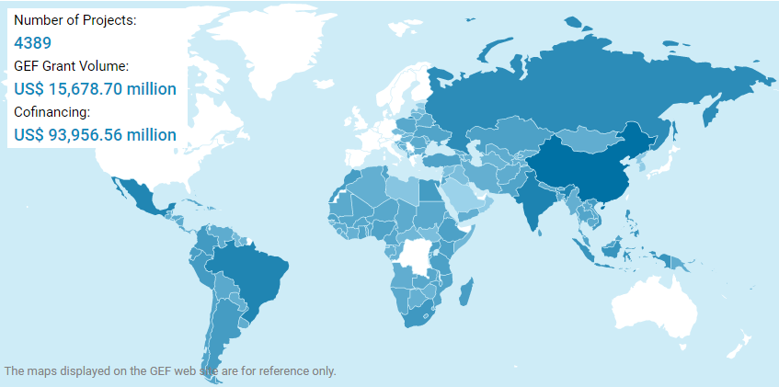
U.N. Global Environment Facility
1.
Check

Slide 67
Service Levels |  |  |  |  | Operational Support
Services | Private | City&Bis | Country | UN&MG | Marketing | HRM | Finance | Policy | Mg. Bur.
TON | .../Emile | RICHARD | INGRID + CATHY | .../Emile | Wendie | SIBEL + SAMAR | HAROLD | Nicolas | CHRISTELLE
Fund for Funds | Resarch | Resarch | Global Mgt. | Focus Groups | PR - Branding | Planning | Funding | Strategy | EvE Office
Consultancy | Experts | Experts | R&D, Toolkits | Experts | Website | Recuit | Admin. | Accreditation | C & B sup.
Education | Program | Program | Countries | Program | Members+ | Admin. | Oper.Fin | Process Eng. | Mgt. Team
CDM | Projects | Projects | PDD | Projects | Events | Job support | Asset Mgt | Scorecard | Key Partners
SDG | Partners | Partners | Partners | Partners | News & MM | Education | Control | Security | General
Projects | EVS Education |  |  |  | Language |  | Legal | ICT | ECOIntention

Slide 68
Meet the Team
Nicolas Gros de Seta– Lead Link
Snuhee Lahiri – ICT

Slide 69
Policy
Strategy
Accreditation
Process Eng.
Scorecard
Security
ICT

Slide 70
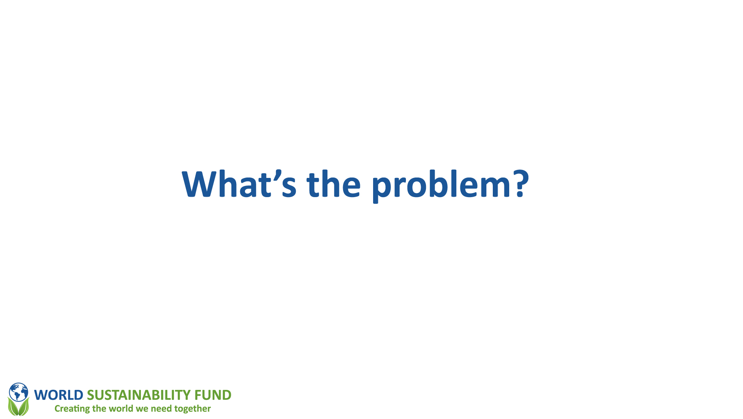

Slide 71
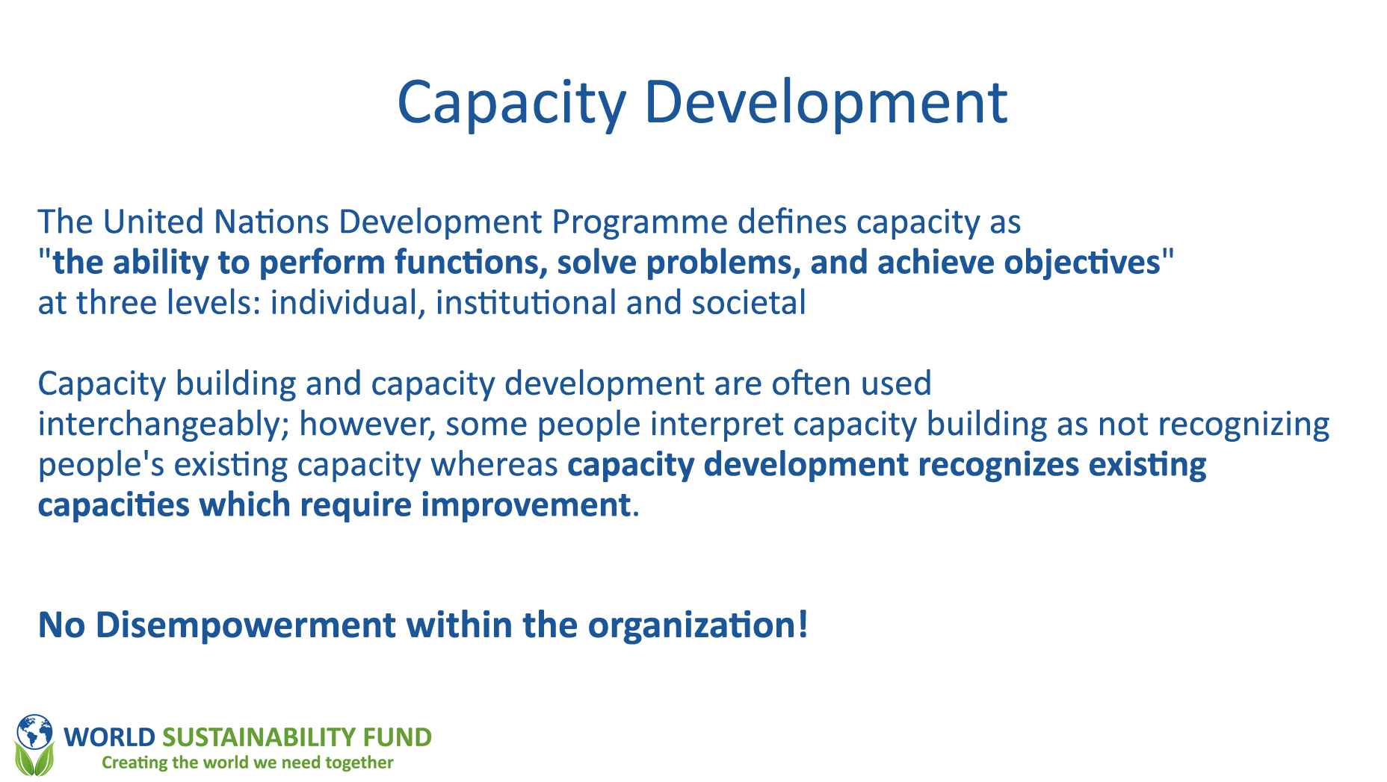

Slide 72


Slide 73
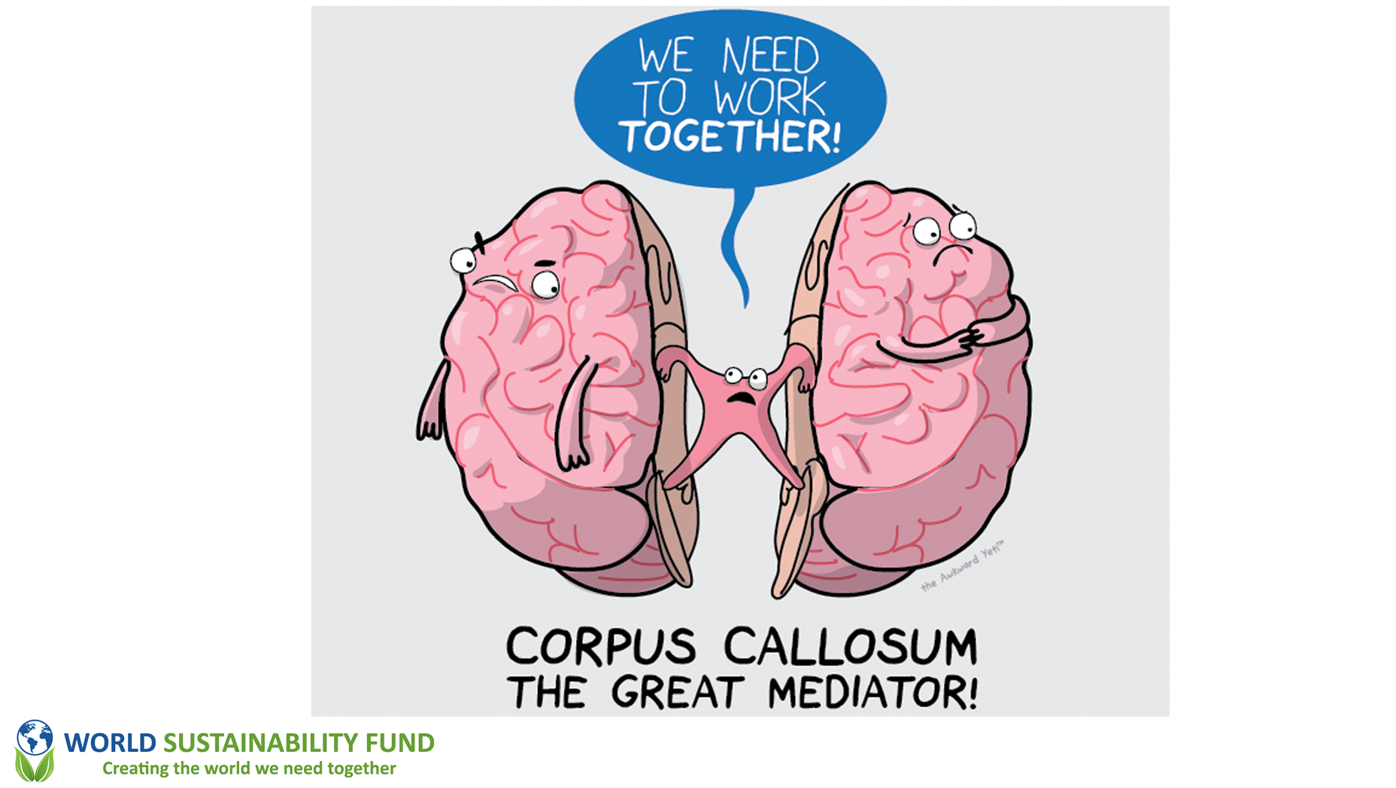

Slide 74
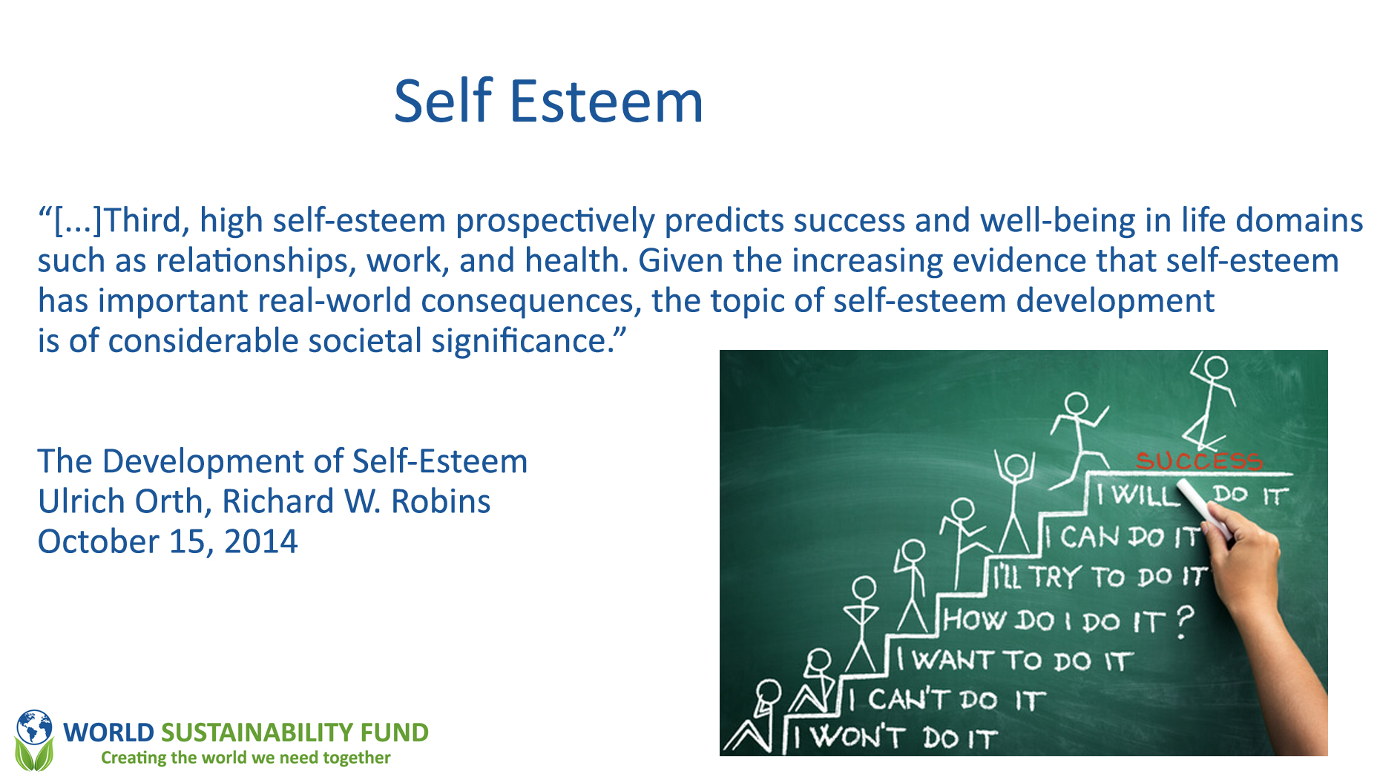

Slide 75
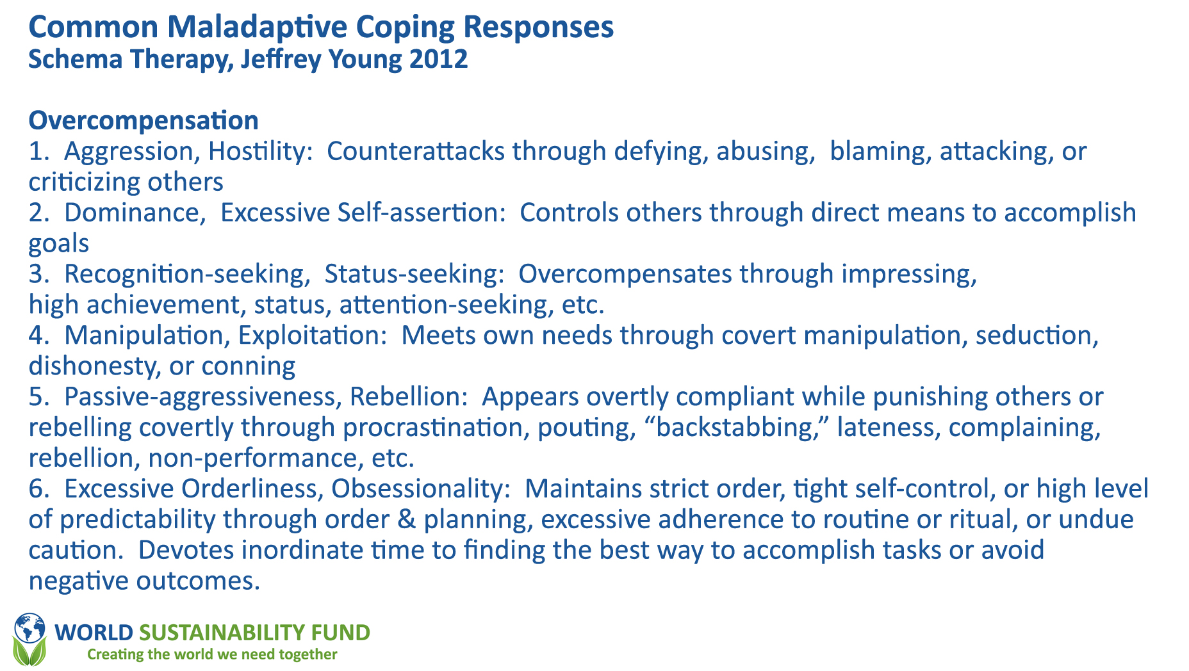

Slide 76
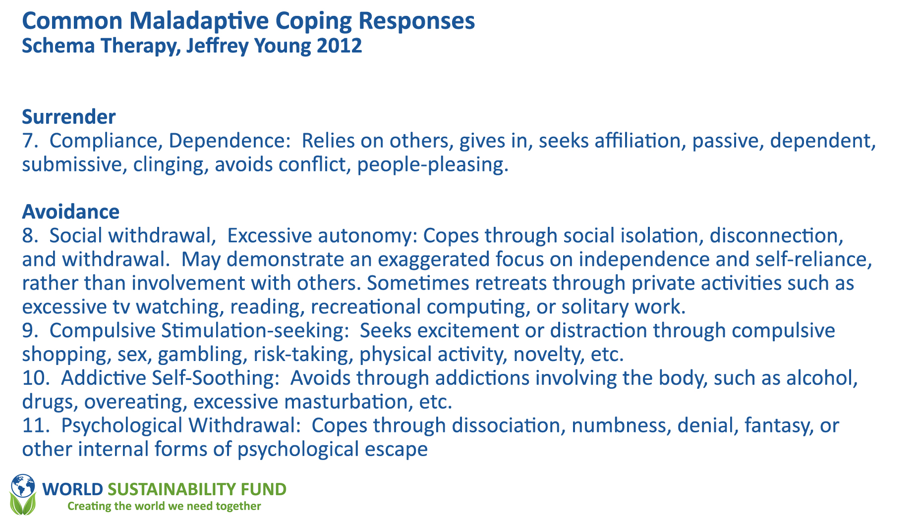

Slide 77
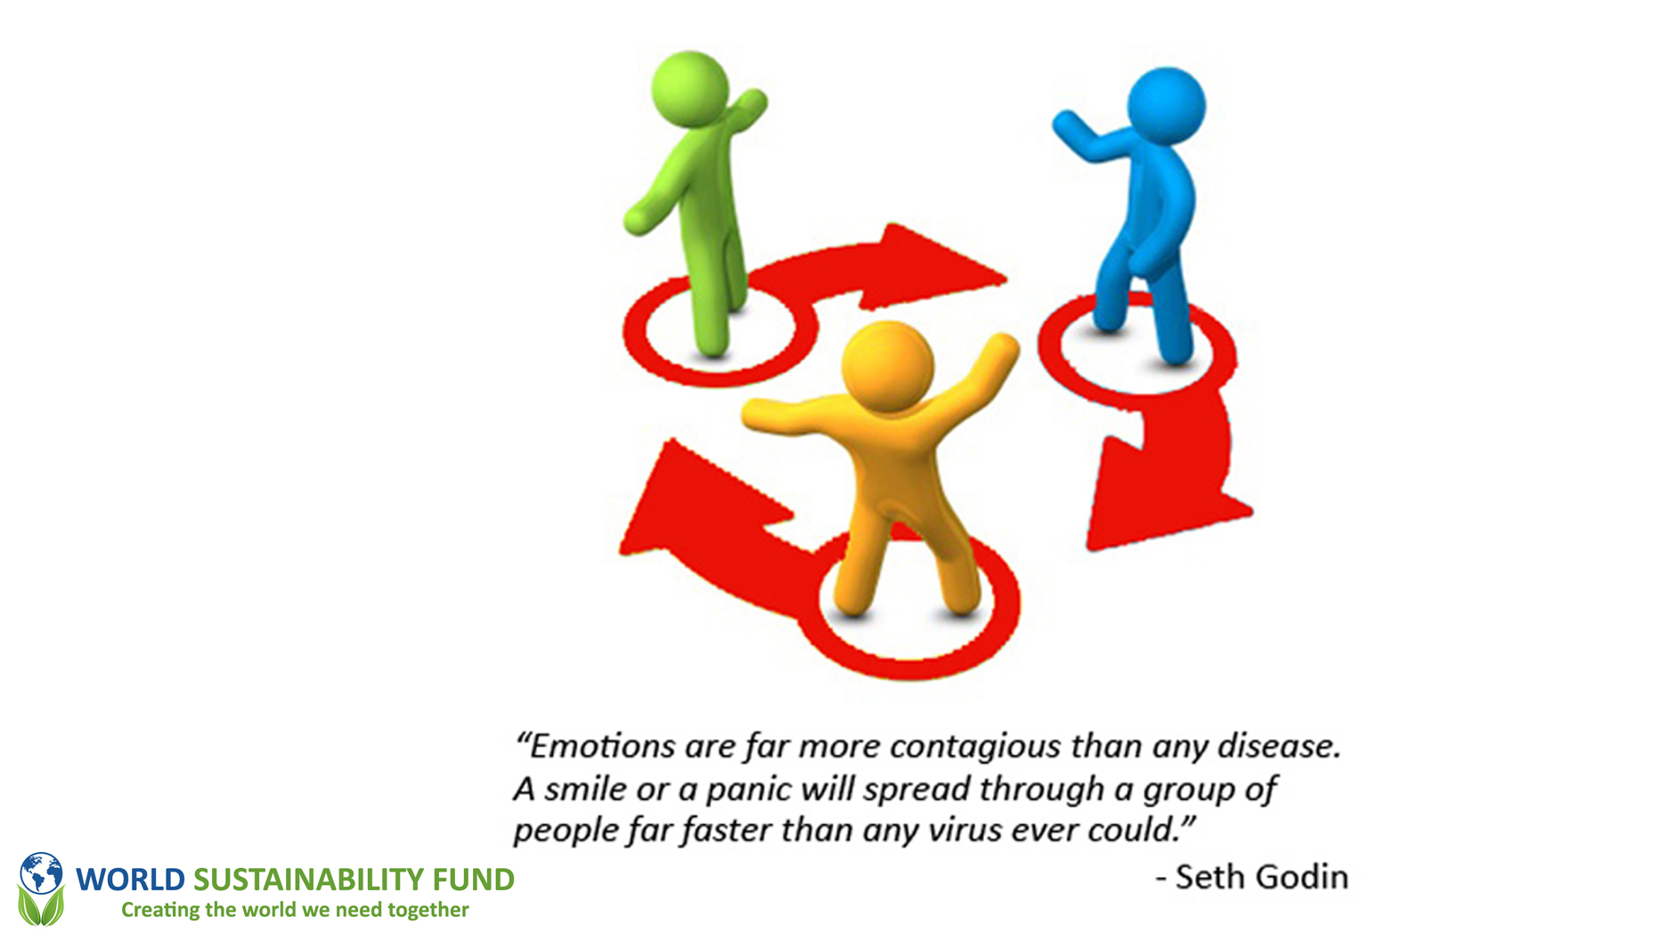

Slide 78
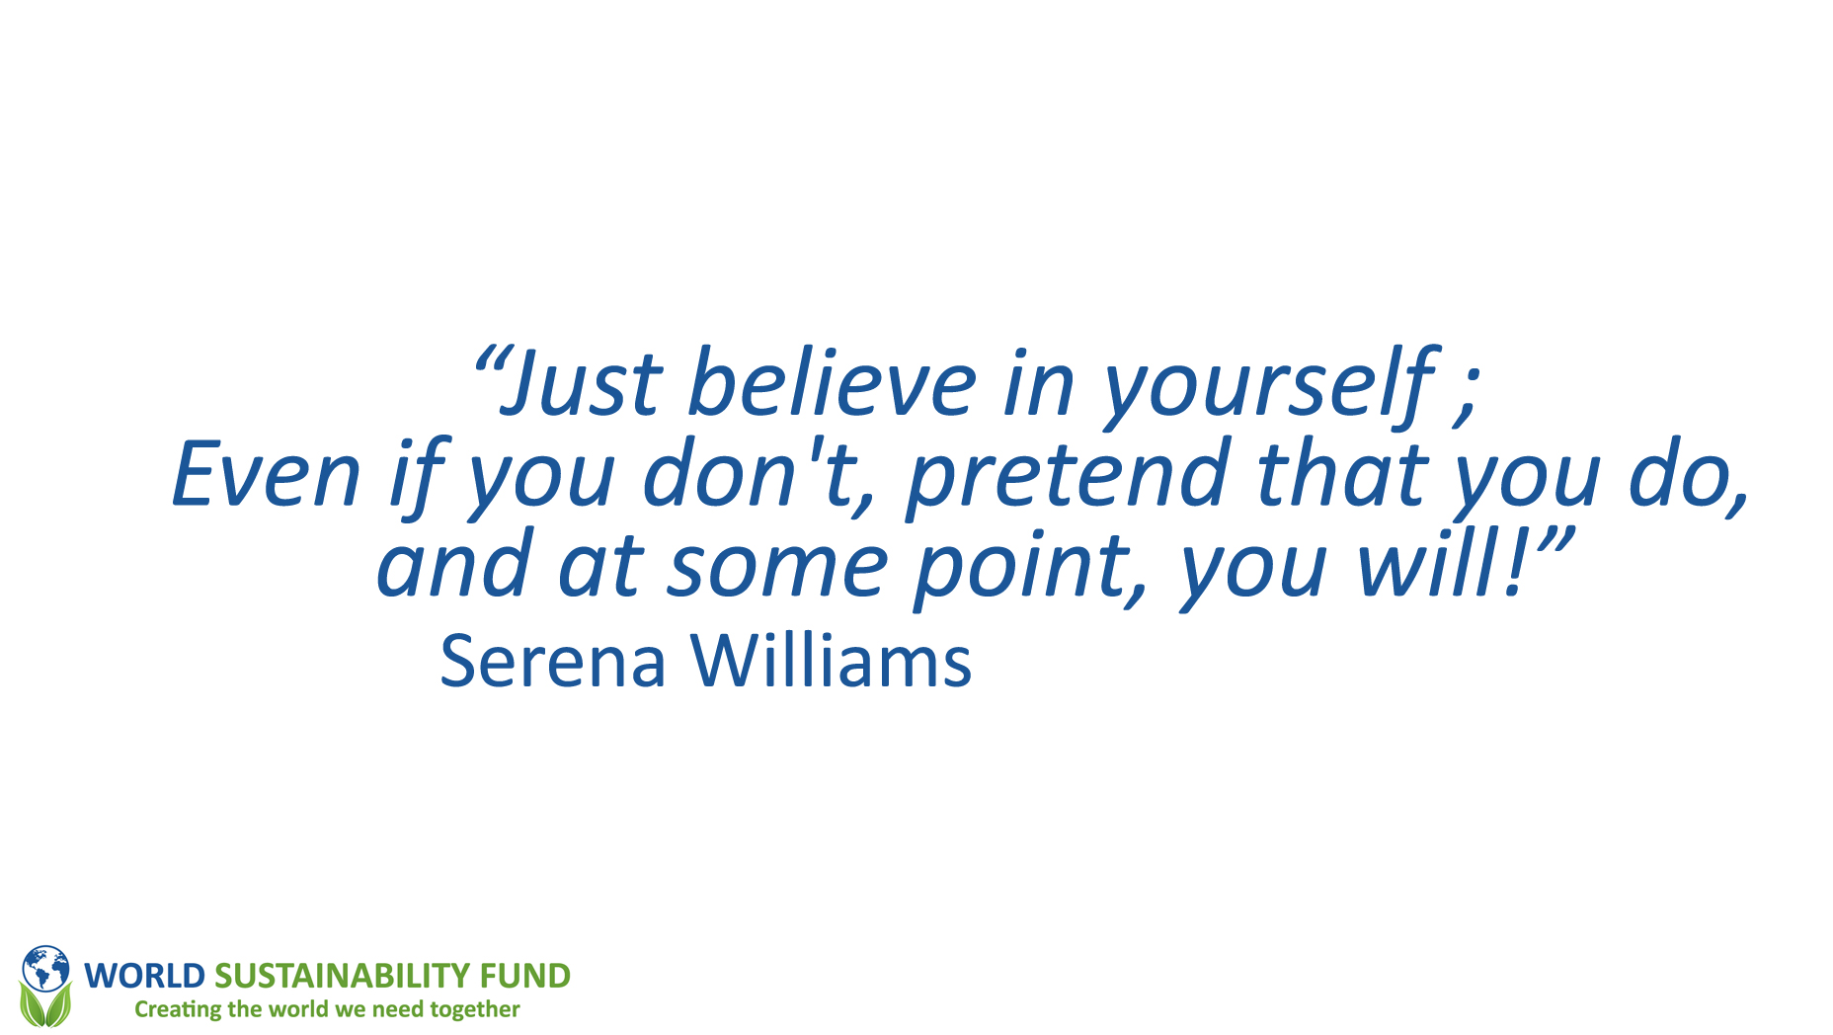

Slide 79
Service Levels |  |  |  |  | Operational Support
Services | Private | City&Bis | Country | UN&MG | Marketing | HRM | Finance | Policy | Mg. Bur.
TON | .../Emile | RICHARD | INGRID + CATHY | .../Emile | Wendie | SIBEL + SAMAR | HAROLD | Nicolas | CHRISTELLE
Fund for Funds | Resarch | Resarch | Global Mgt. | Focus Groups | PR - Branding | Planning | Funding | Strategy | EvE Office
Consultancy | Experts | Experts | R&D, Toolkits | Experts | Website | Recuit | Admin. | Accreditation | C & B sup.
Education | Program | Program | Countries | Program | Members+ | Admin. | Oper.Fin | Process Eng. | Mgt. Team
CDM | Projects | Projects | PDD | Projects | Events | Job support | Asset Mgt | Scorecard | Key Partners
SDG | Partners | Partners | Partners | Partners | News & MM | Education | Control | Security | General
Projects | EVS Education |  |  |  | Language |  | Legal | ICT | ECOIntention

Slide 80
Meet the Team
Christelle Doumit – Lead Link
Nadia Almouji – EvE office
Jacqueline Odongo- General
Objectives
To grow the department
To create a work plan for the management bureau
To implement guidelines starting the new year
To look for new people to join the circle
The process structuring the circle is in progress

Slide 81
Policy
Finance
Services
HR
Mgt Bureau
Private
Marketing
City & Business
UN & MG
Country

Slide 82

Management Bureau
EvE office
C&B Support
Mgt. Team
Key partners
General
ECOintention

Slide 83
Q&A

